Slide 1



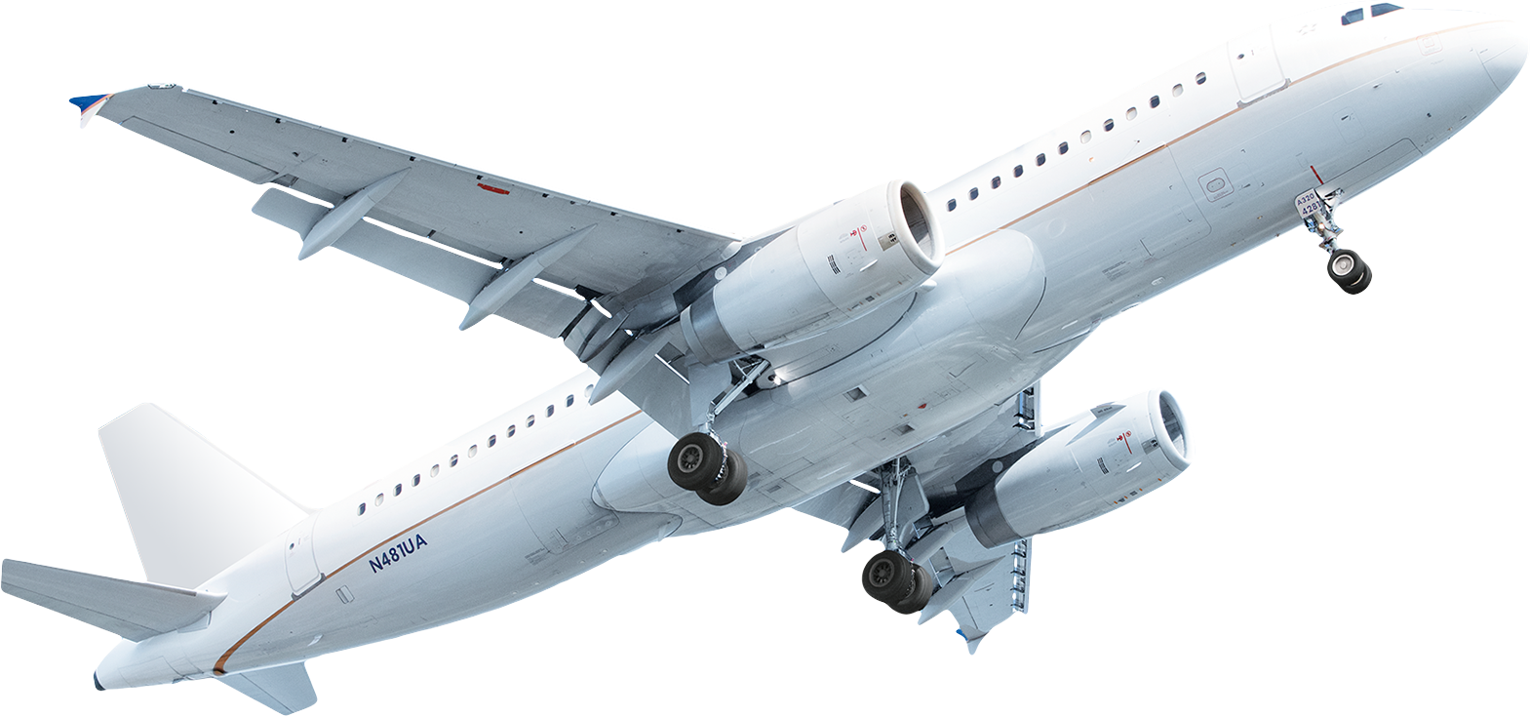




AIR TRAVEL SAFETY
Fatalities - Aviation vs. Other transportations
0.07
Aviation Deaths
Per bn Passenger Miles
2000-2009
98.3%
1.4%
0.3%
0.03%
Aviation Accident Trend
53.7%
Accident Rate
Last 10 Years
None of the top 5 airlines with
most fatalities history since
1985 are from first world
countries
TAP stands out as the safest carrier with 0 incident while China airlines stand at the other end with 781 incidents (between 1985 – 2008)
Sources
Final project dataset
http://www.cityam.com/215834/one-chart-showing-safest-ways-travel
https://www.icao.int/safety/iStars/Pages/Accident-Statistics.aspx

